Slide 1

Final Project BDAT 1004
DATA PROGRAMMING

Slide 2
Project Summary
Dhartiben Kantibhai Patel
Umang Pradipkumar Patel
Jay Babulal Patel
Group – 10
Section -2

Slide 3
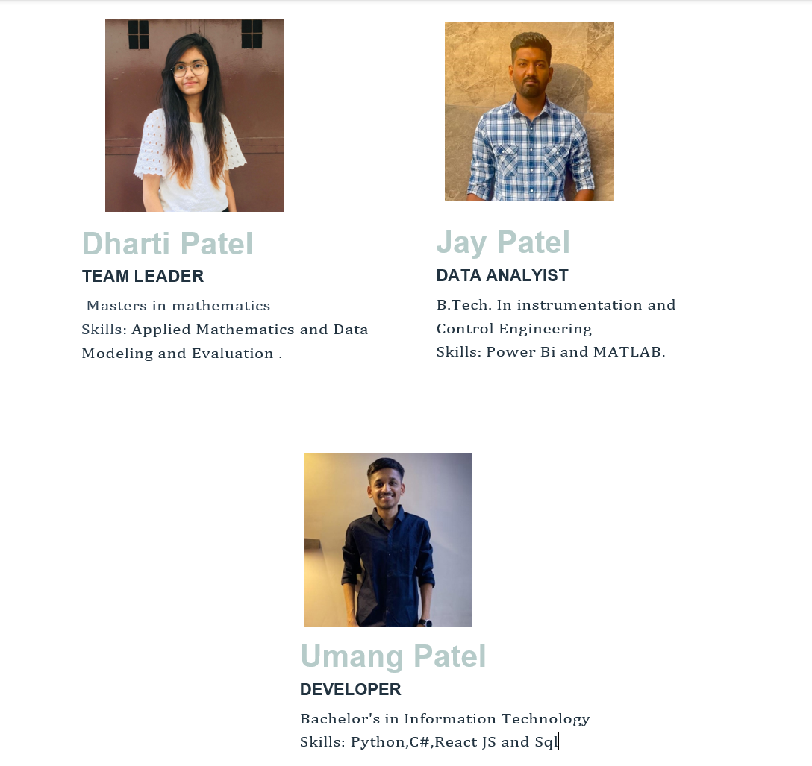
Meet The Team

Slide 4
Roles and Skills of Team members
Dharti Patel(Project Manager): Our project manager ensures the timely delivery of project milestones and works closely with the business analyst to build the necessary documentation for the proposal.
Umang Patel (Developer): Our developer is responsible for developing the software front and back end. They have expertise in Python, Flask ,Java script and CSS.
Jay Patel(Data Analyst Name): Our data analyst is responsible for acquiring data, building data models, and creating databases if needed. They have expertise in Power bi Statistical programming, Machine learning

Slide 5
Skills :
Data visualization: A key feature of a stock database website would be the ability to display data in meaningful and informative ways. Skills in data visualization and dashboard design would be necessary to create intuitive and informative displays of stock market information.
Web development: Of course, the website itself would need to be well-designed and easy to use. Skills in web development, including front-end and back-end development, user experience design, and responsive design, would be important for creating a high-quality user experience.
Financial analysis: A stock database website would likely include tools and resources for financial analysis, such as stock screeners, technical analysis tools, and fundamental analysis tools. Skills in financial analysis, including knowledge of financial ratios, technical indicators, and other key financial metrics, would be necessary for creating these features.
In conclusion, our team has the skills and expertise necessary to deliver high-quality results for our clients. We are confident that our latest project will be a success thanks to the hard work and dedication of our team members.

Slide 6
Data set
A real-time stock price data set would provide up-to-the-minute information on stock prices for a wide range of publicly traded companies. This data set would include current stock prices, as well as information on trading volume, bid-ask spreads, and other key market data.
Real-time stock price data is typically available through APIs (application programming interfaces) that allow developers to access the data programmatically. These APIs can be integrated into trading platforms, financial news websites, and other applications that require real-time market data.

Slide 7
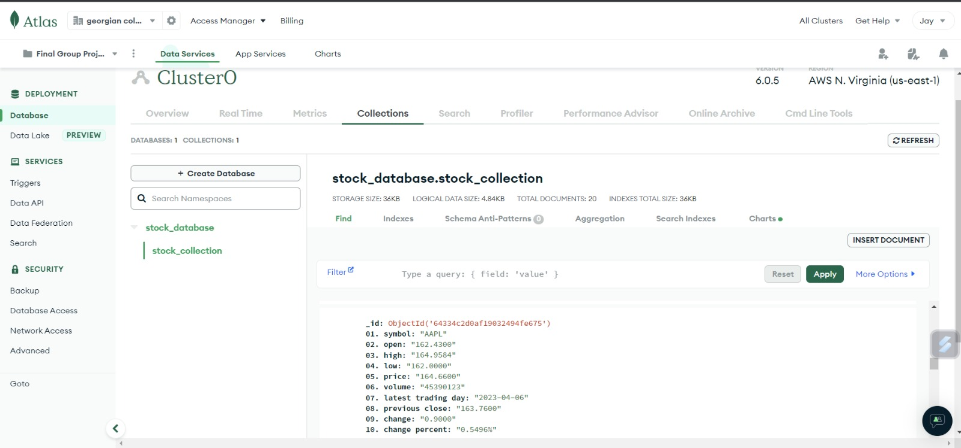

Slide 8



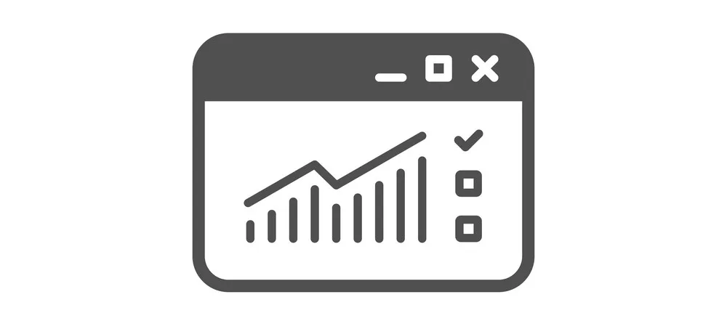
Web Application
Our web application is designed to provide real-time updates on stock prices and comparisons between different stocks. The application uses a real-time stock data set, which is converted into a database for easy access and analysis. The database contains current stock prices, as well as historical data that can be used to track trends and analyze performance over time.
The web application presents this data using different types of charts, such as line charts and pie charts, to help users visualize the data and understand market trends. Line charts can be used to show the performance of individual stocks over time, while pie charts can be used to compare the performance of different stocks within a given time period.

Slide 9
Web Application
The web application may also include other features, such as real-time news updates, alerts for price changes or other market events, and tools for technical analysis or financial modeling. Users can customize the application to suit their needs, such as selecting the stocks they want to track, adjusting chart settings, or setting up alerts for specific events.
Overall, our web application provides a valuable tool for traders, investors, and analysts who need real-time access to stock market data and want to analyze performance and compare different stocks using interactive charts and other visualization tools.

Slide 10
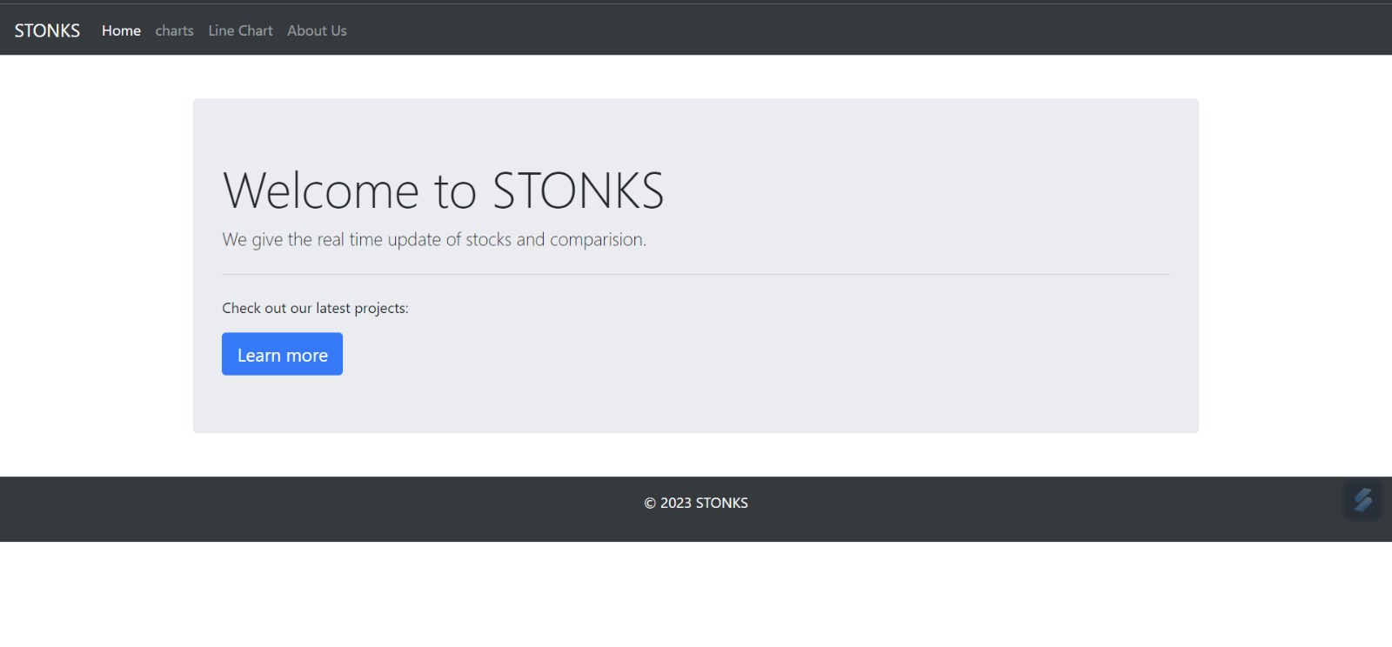
Screenshots Of Web Application

Slide 11
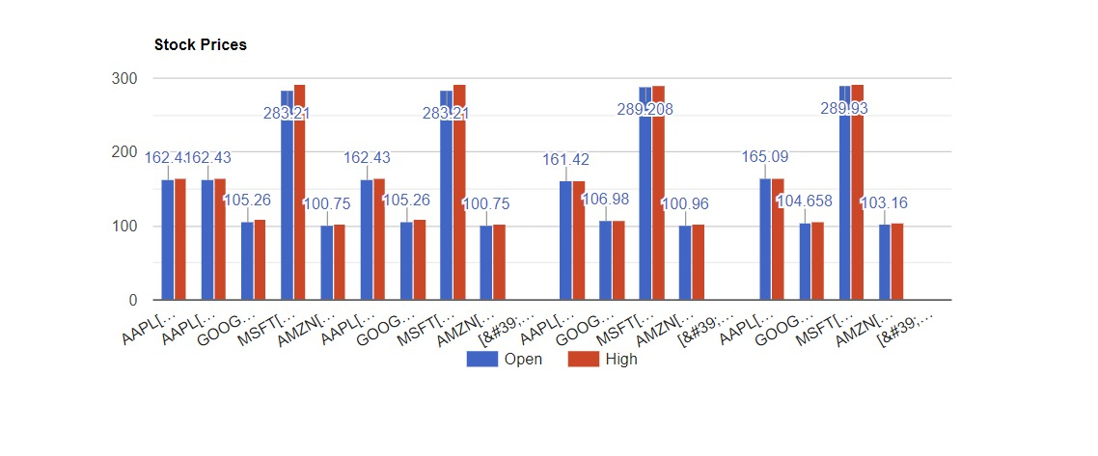

Slide 12
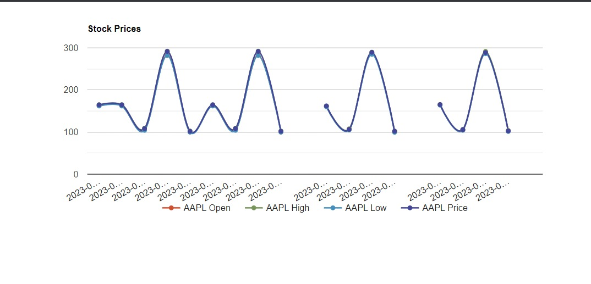

Slide 13
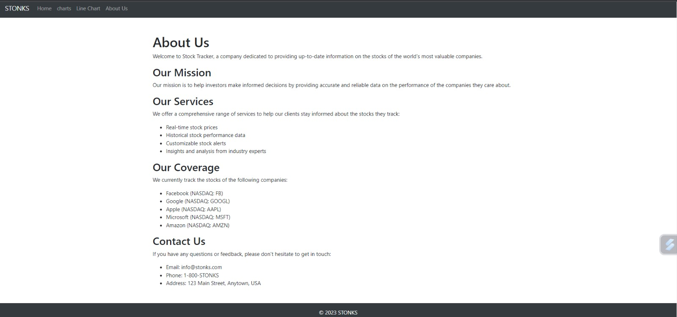

Slide 14

GitHub Link
https://github.com/Jayp1212/BDAT1004-Final-Project-Group-10

